Slide 1



Explainability and Interpretability
Luis Miralles

Slide 2
Lesson Outline
Main concepts in Explainability
Examples of Explainability methods
ML Explainable Approaches

Slide 3
Summary of lecture
Explainability vs. Interpretability: Distinguish between understanding internal model workings and customising user knowledge.
ML Explainable Approaches: Choose model-agnostic or model-specific methods. Consider local vs. global interpretation and surrogate models or visual aids.
Examples of Explainability Methods are LIME, SHAP, and LRP.

Slide 4

Section 1 – Concepts in Explainability

Slide 5
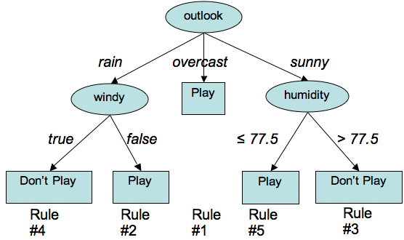
Concept of interpretability
Interpretability refers to how easily an AI/ML model can be understood.
It is determined by the inherent design of the model.
Using a simple, human-readable model like a decision tree demonstrates good interpretability.

Slide 6

Explainability
Explainability clarifies an AI/ML model's internal workings for a specific audience.
It involves providing information in statements to clarify, offer context, or justify a prediction.
An example is creating a complex model that can explain why it made a specific decision.
The target audience is crucial for explainability, as the type and comprehensibility of explanations depend on the recipient.
What's evident to a group of doctors might be incomprehensible to a layperson.

Slide 7
The difference between Explainability and Interpretability
Explainability involves customising knowledge for a specific user, making it more user-friendly.
Interpretability is concerned with understanding the internal essence of the model.
Some researchers prefer Interpretability (Interpretable ML) over Explainability (XAI) because they are concerned that explaining black-box models can lead to errors.
XAI helps simplify complex models and assess their trustworthiness.
XAI and Interpretability can complement each other, with one being more suitable in specific cases.
"In-model" explainability involves using interpretable ML models alone or alongside black box models.

Slide 8
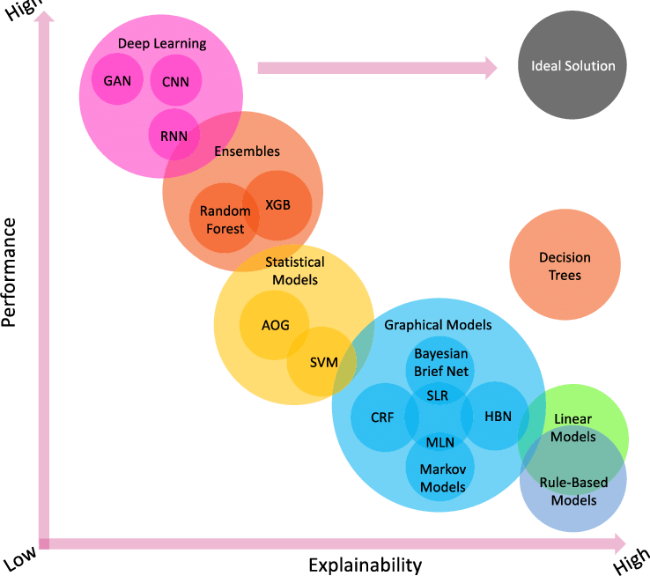
Comparing performance with explainability
Interpretability
Yang, G., Ye, Q., & Xia, J. (2022). Unbox the black-box for the medical explainable AI via multi-modal and multi-centre data fusion: A mini-review, two showcases and beyond. Information Fusion, 77, 29-52.

Slide 9
Introducing the different concepts

Slide 10

Accountability
Accountability in data protection is crucial, spanning various fields like finance and accounting.
High-profile scandals in the 1990s necessitated increased accountability in financial institutions.
Accountability involves holding individuals and companies responsible for their actions, with legal consequences for negligence.
External auditors periodically examined companies to ensure accountability.
Explainable Artificial Intelligence (XAI) requires providing justifications for actions to a relevant audience.
If an algorithm discriminates against someone, an explanation is needed for justice.
Companies and organisations must align their technology with regulations like GDPR to ensure accountability.

Slide 11

Trustworthiness
Professionals require clear explanations to trust models' predictions.
Researchers initially prioritised model accuracy over explainability.
The importance of explainability became evident when professionals hesitated to use models without clear explanations.
Trust in ML models is crucial for professionals to make decisions using them confidently.
Trustworthiness is established by providing evidence and logical explanations for predictions.

Slide 12

Causality
Many modern machine learning methods, including Deep Learning, require extensive data to identify correlations and patterns related to various causes.
It's crucial to differentiate between correlation and causation in these models.
Models primarily based on correlation cannot generalise and adapt to new situations. For instance, a model trained on one type of camera may struggle with images from a different camera.
There's a need for models that can detect cause-effect relationships and adapt to changing environments. Examples of cause-effect relations include things breaking when they're hit or falling from a table's edge.
Developing models that understand the underlying logic between different events can lead to better and more satisfactory explanations.

Slide 13


Difference between correlation and cause-effect
There is a correlation between people wearing sunglasses and people eating ice cream.
There is a cause-effect relationship between the ice cream melting and the heat.

Slide 14

Confidence
Some ML models offer a confidence score, typically between 0 and 1, indicating the likelihood that a decision is correct.
Laypeople's trust in a model depends on the model's overall performance and the confidence score of individual predictions.
High model accuracy (e.g., 98%) and a high confidence score (e.g., 0.95) make users more likely to trust the model's predictions.
Even providing users with low confidence scores can be valuable because it informs them that the model is uncertain, leading them to take the decision less seriously.
Offering users information about prediction accuracy increases their trust in the model.

Slide 15

Fairness and ethical decision
Algorithms play a crucial role in decisions that impact people's lives, so it is essential to ensure that ML models do not discriminate based on protected attributes like gender, ethnicity, race, or sexual orientation.
In domains such as banking and criminal justice, historical data can perpetuate bias into the future.
To ensure fairness across different groups, three norms can be applied, as indicated by previous publications:
a) Anti-classification: Protected attributes are not used in decision-making.
b) Classification parity: Errors (false positives and false negatives) remain consistent across various groups.
c) Calibration: The percentage of model decisions, such as loan approvals, should be uniform across different groups.

Slide 16
Short definitions
Accountability: Holding models or developers responsible for their outcomes.
Trustworthiness: The reliability and integrity of model predictions.
Causality: Understanding cause-effect relationships in model predictions.
Fairness and ethical decision: Ensuring models treat all groups equally and make morally sound choices.
Confidence: A model's certainty about its predictions.

Slide 17

Section 2 – Examples of Explainability methods

Slide 18
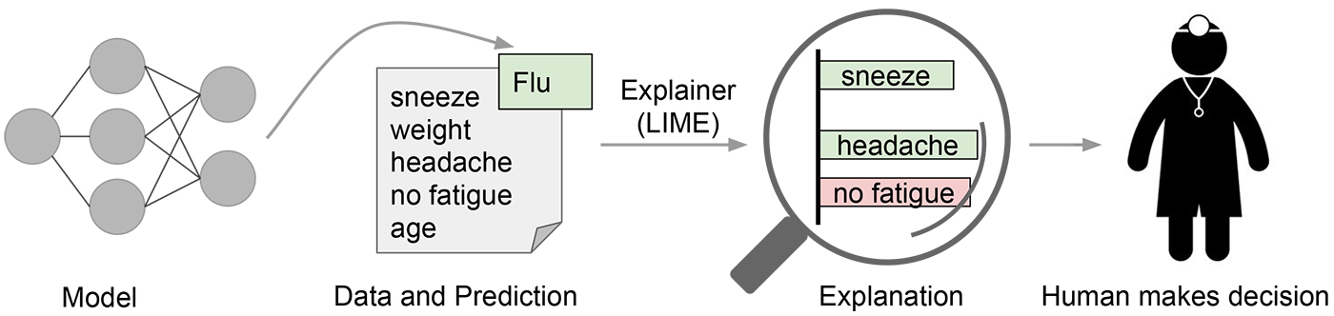
LIME (Local interpretable model-agnostic explanations)
Type: Model-Agnostic (Post-hoc)
Explanation Approach: LIME explains an instance prediction using a linear interpretable model (surrogate model) as a local approximation, considering the target, input features as drivers, importance scores as the explanation family, and computed through local perturbations of the model input as the estimator. It works on all black-box models and data types.

Slide 19
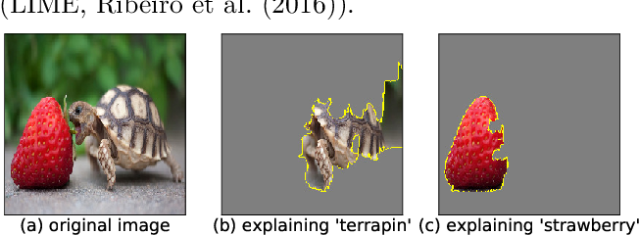
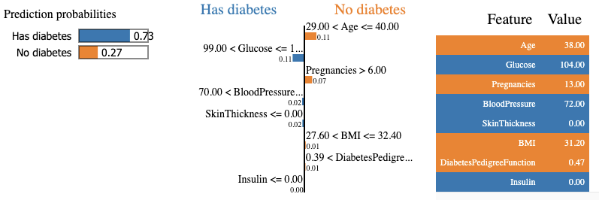
Interpreting LIME models
Which parts of the image are
more relevant to predict the output.
Which variables and values have a more a positive or negative impact on the predicted class
https://homes.cs.washington.edu/~marcotcr/blog/lime/

Slide 20
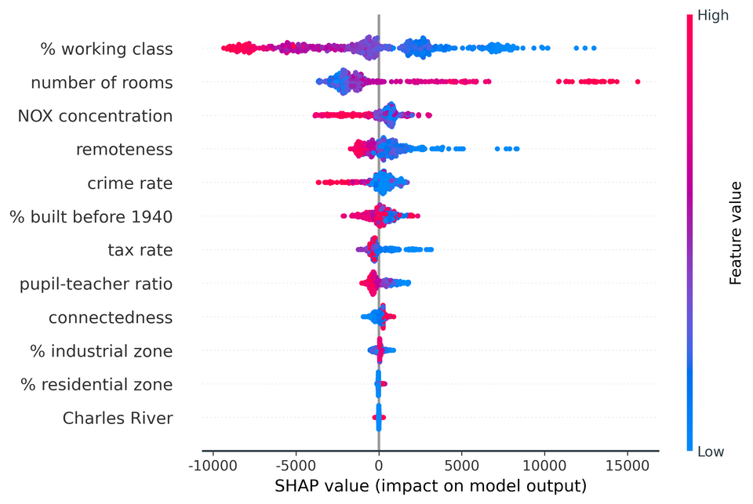
SHapley Additive exPlanation (SHAP)
Type: Model-Agnostic
Explanation Approach: SHAP generates feature importance using Shapley values based on cooperative game theory. It can explain both individual predictions and a model's global behaviour. Model-specific versions, like TreeSHAP and Deep SHAP, exist for decision trees and DNNs.
https://towardsdatascience.com/understand-the-working-of-shap-based-on-shapley-values-used-in-xai-in-the-most-simple-way-d61e4947aa4e
https://www.aidancooper.co.uk/a-non-technical-guide-to-interpreting-shap-analyses/

Slide 21
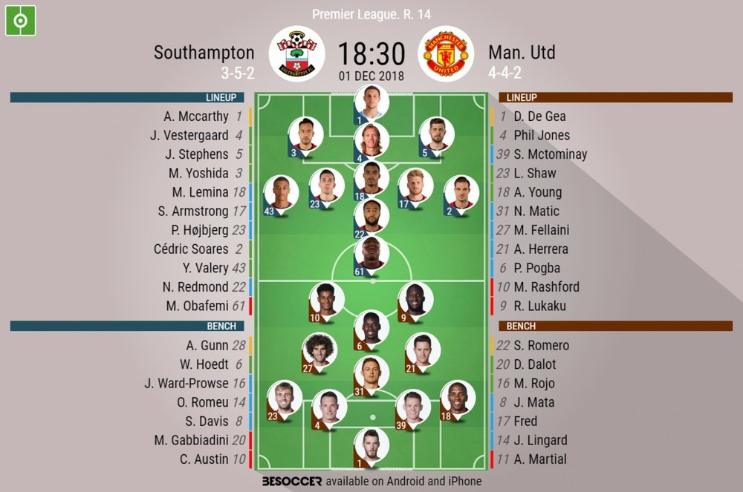
Manchester United - Line up

Slide 22
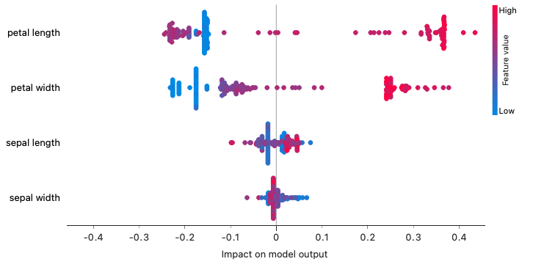
How do we interpret this plot?

Slide 23
SHAP for explaining the Iris dataset
The more the value is to the right or to the left the more is impacting.
Target class: Iris-virginica
Red values are pushing to predict the target.
Variables are sorted from more impact to less impact in the model.
The more intense the red the higher the value of the feature.
The more intense the blue the lower the value.
Blue values are pushing to not predict that value.
If it is in the middle the value is half-way.
There are a lot of instances making negative contributions (-0.2) against predicting Iris-Virginica.
There are few instances making positive contributions (+0.1) towards predicting Iris-Virginica.

Slide 24
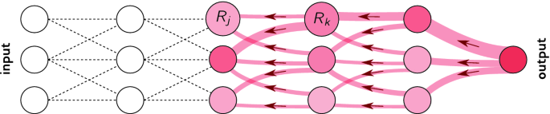
Layerwise Relevance Propagation (LRP)
Type: Model-Specific
Explanation Approach: LRP explains deep neural networks by decomposing them into different layers. It identifies relevant inputs for predictions and considers activation scores of neurons through backpropagation to highlight meaningful pixels in images.

Slide 25
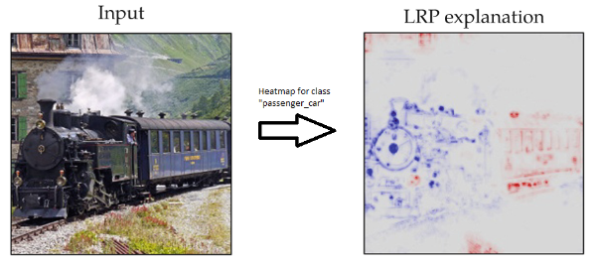
LRP for Images
Explanation obtained for the output neuron “passenger_car”, shown as a heatmap. Here, features(pixels) of the image that represent “passenger car” are highlighted in red, indicating its positive relevance in deciding the class “passenger_car” at the output
https://praveenkumar2909.medium.com/overview-of-explainable-ai-and-layer-wise-relevance-propagation-lrp-cb2d008fec57

Slide 26

Section 3 – ML Explainable Approaches

Slide 27

Model-Agnostic vs Model-Specific
Model-agnostic methods don't consider the internal components of the model, making them suitable for any black-box approach.
Model-specific methods are defined using parameters specific to the individual model, like interpreting linear regression weights.

Slide 28

Local vs Global
Local interpretable methods use specific outcomes or predictions of the model to generate explanations.
Global methods consider the overall behaviour of the model.

Slide 29

Surrogate vs Visual Aid
Surrogate models approximate the predictions of a black-box model for explanation purposes.
Visual aids help present explanations more understandably, often using graphs, scatter plots, heatmaps, etc.

Slide 30

Pre-model, In-model vs Post-model Strategies
XAI can be applied throughout the model's developmental pipeline.
Pre-model explainability focuses on data summarisation before model development, dataset description, feature engineering, and exploratory data analysis.
In-model explainability aims to develop inherently explainable models or enhance black-box models with explanations. Approaches include hybrid models and joint prediction-explanation models.
Post-model explainability methods extract explanations for pre-developed models. These methods operate based on target, drivers, explanation family, and estimator characteristics.

Slide 31
References
Wang, S., Qureshi, M. A., Miralles-Pechuán, L., Huynh-The, T., Gadekallu, T. R., & Liyanage, M. (2021). Applications of Explainable AI for 6G: Technical Aspects, Use Cases, and Research Challenges. arXiv preprint arXiv:2112.04698.
Flaticon.com
Ribeiro, Marco Tulio, Sameer Singh, and Carlos Guestrin. "Why should I trust you?" Explaining the predictions of any classifier." Proceedings of the 22nd ACM SIGKDD international conference on knowledge discovery and data mining. 2016.
Lundberg, Scott M., and Su-In Lee. "A unified approach to interpreting model predictions." Advances in neural information processing systems 30 (2017).
Montavon, Grégoire, et al. "Layer-wise relevance propagation: an overview." Explainable AI: interpreting, explaining and visualising deep learning (2019): 193-209.
Yang, G., Ye, Q., & Xia, J. (2022). Unbox the black box for the medical explainable AI via multi-modal and multi-centre data fusion: A mini-review, two showcases and beyond. Information Fusion, 77, 29-52.

